Slide 1
Meet Fidelis Security
The Trusted Leader in Cybersecurity for Enterprise and Government
Damir Hrs
E-Mail: damir.hrs@4sec.hr

Slide 2
Who We Are
20+
years
Over twenty-years-strong and backed by the fastest-growing software conglomerate in the world, Fidelis Security remains at the forefront of cybersecurity innovation.
of
innovative
We deliver proactive solutions that keep enterprises resilient against even the strongest and most advanced adversaries.
cyber
defense
Fidelis Security exists as the first and last line of defense (and at every point in between) to secure the world’s networks from whatever lies ahead.

Slide 3
Fidelis History & Innovation
Data Loss Prevention
Fidelis Network
Fidelis Endpoint
Fidelis Deception
Fidelis Elevate / Active XDR
Fidelis Halo
Fidelis Decryption
2002
Fidelis Founded.
Network Security and DLP
Patented, in-memory session and metadata analysis delivers unique visibility
2012
Acquired by General Dynamics Advanced Information Systems division
2015
Leadership has a new vision for the market – integrated and automated network and endpoint security in a single platform
2017
Acquires Deception product providing total visibility and automated
2018
Fidelis Platform: Fidelis Elevate, Automated Detection, Hunting and Response (Open Active XDR)
2021
CloudPassage
Acquisition
2022
Fidelis Halo
Integration
2015
Fidelis taken out of GD and goes private
2015
Acquired EDR product. Started engineering Network + Endpoint integration. Added deep file analysis, deep session analysis, deep malware analysis, deep packet inspection, deep content inspection and ML
2023
Partner One Acquisition
GD
Full Spectrum Cyber Defense
Private
Cloud Security
Founded
Vision
Endpoint
Deception
Headquarters:
Riverside, California
Continuous Innovation

Slide 4

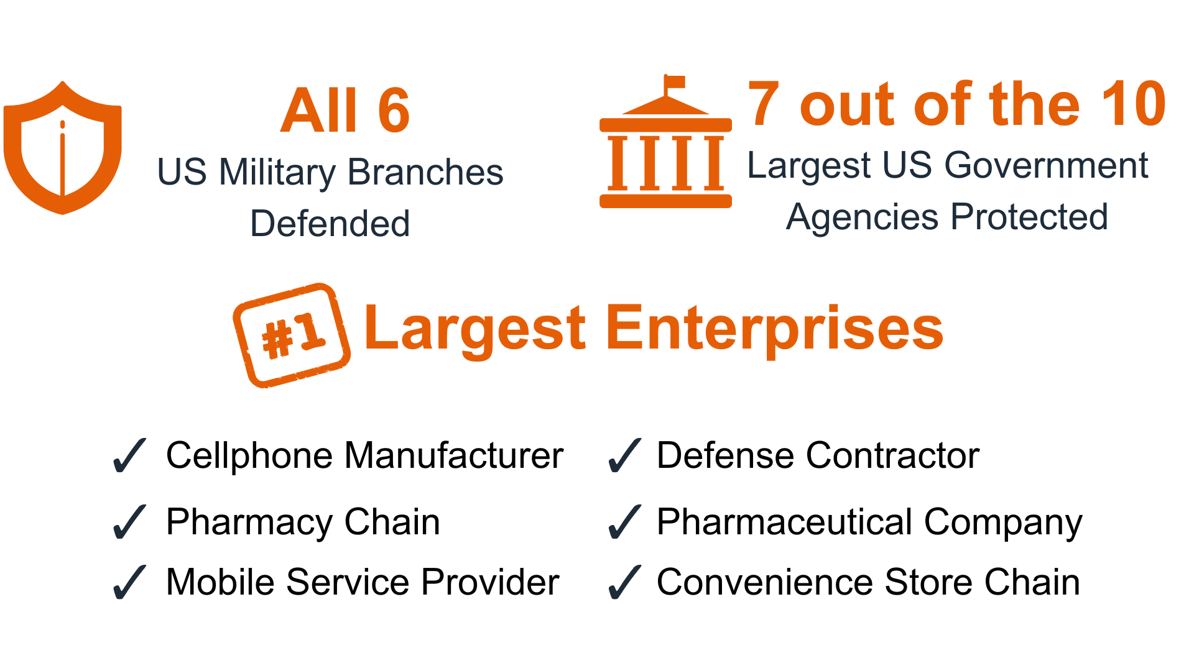
Fidelis Protects the Most Critical Data on Earth

Slide 5
Security Magazine
$10.5 Trillion
39 Seconds
49 Days
expected cost of cyber-crime damage by 2025
($255,000 every second)
there is a hacker attack
average amount of time it takes to identify a Ransomware attack
Riskiest Industries
$265 Billion
$4.24 Million
Critical infrastructure
Electric
Gas and water utilities
Hospitals
Banks
Telecommunications
Technology
Chemicals
Energy
Transportation services
estimated cost of ransomware by 2031
average cost of a data breach
200 Zettabytes
3.5 Million
of data will be stored globally by 2025
(Half will be in the cloud)
unfulfilled cybersecurity jobs worldwide
(700,000 just in the USA)
Sources: CyberSecurity Ventures, Exploding Topics, SImpliLearn, Get Astra, Security Magazine

Slide 6
Fidelis Security Platforms
Proactive Cyber Defense for Cloud and On-Prem

Slide 7
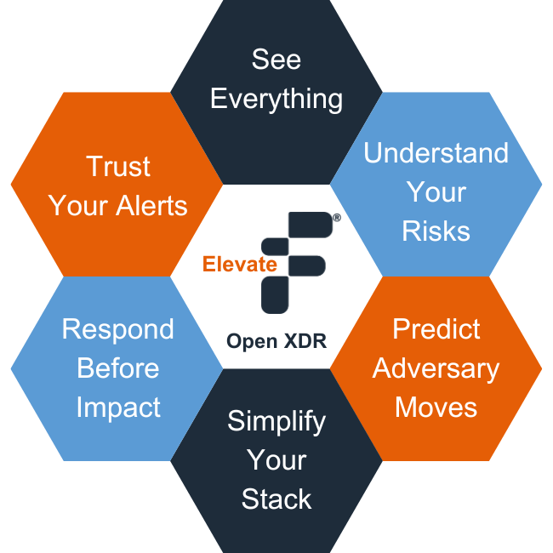
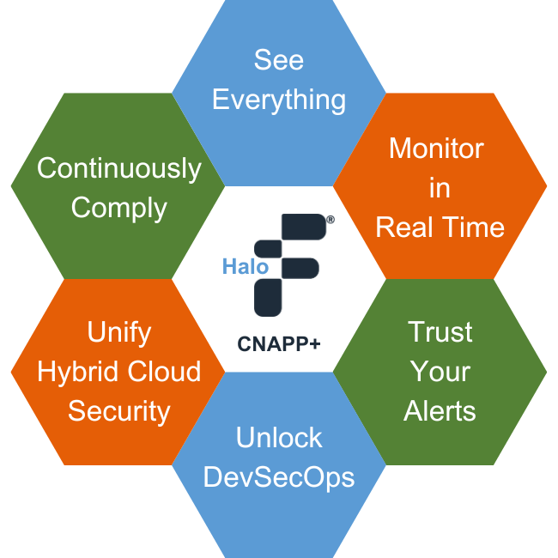
The Fidelis Security Platforms
The Fidelis Elevate® XDR Platform.
Deep Visibility. Expert Forensics. Resilient Response.
The Fidelis Halo® CNAPP Platform.
Unified Visibility. Continuous Compliance. Frictionless Operation.
Deep Session Inspection®
Heartbeat
Cloud
Monitoring
Fast
Incident Response
Adaptive Deception
Automated
FIM & CSM
IoC/IoT
Detection
Threat-informed
Forensics
Real-time
Risk Analysis
Zero Cloud Security Tax
Container Security
Predictive
Anomaly Detection
Endpoint
Threat
Protection
Vulnerability
Monitoring
DevSecOps/
CICD
Ready
Active Directory Intercept™
Active Threat Detection™
Simplified
Compliance
Multicloud&
Hybrid Coverage

Slide 8
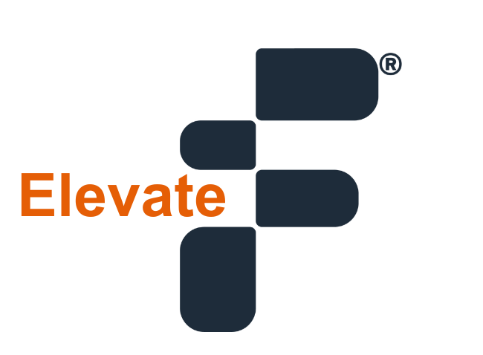
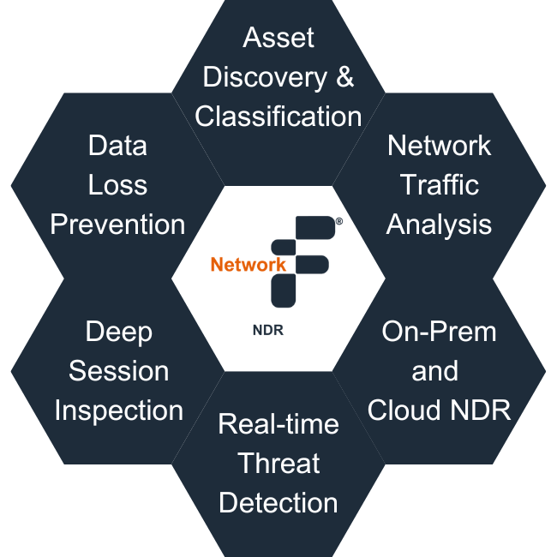
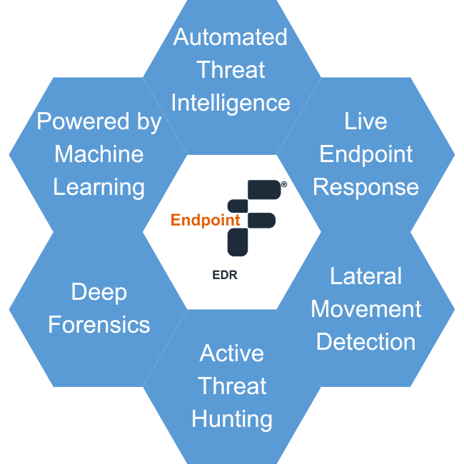
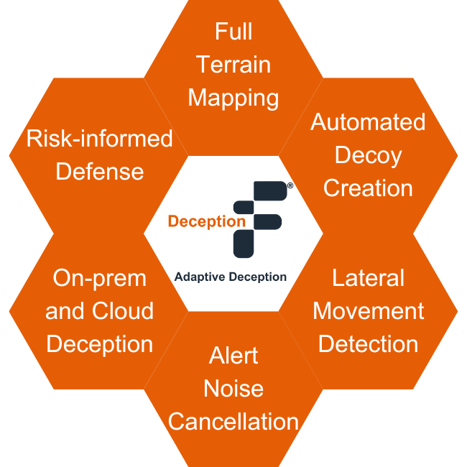
One platform.
One license.
Complete control.

Slide 9
Fidelis Elevate®
Proactive Cyber Defense for the Resilient Organization

Slide 10
Protect
Detect
Respond
Neutralize
Prevent | Predict | Comply

Slide 11
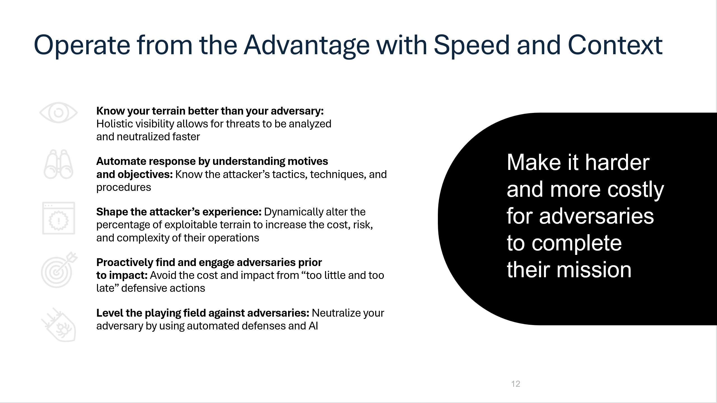

Slide 12
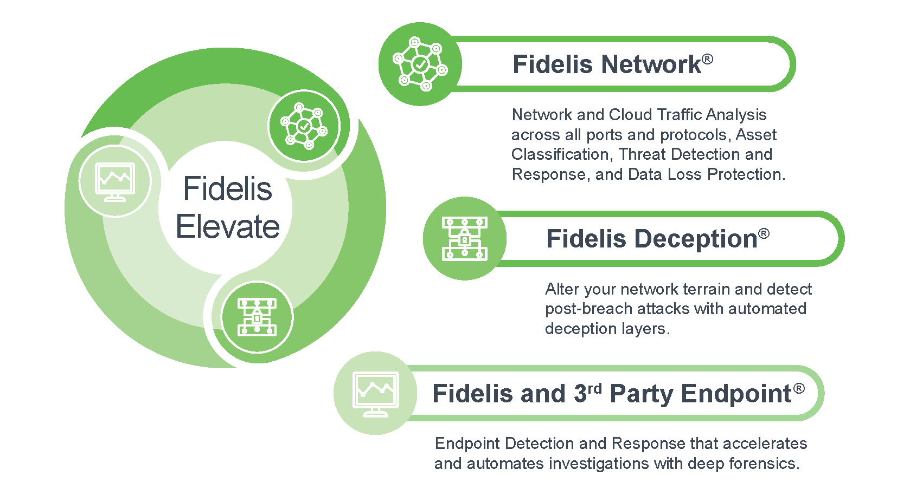
Fidelis Elevate®: Proactive, Integrated Cyber Defense
Fully Integrated, One License, No Modules

Slide 13
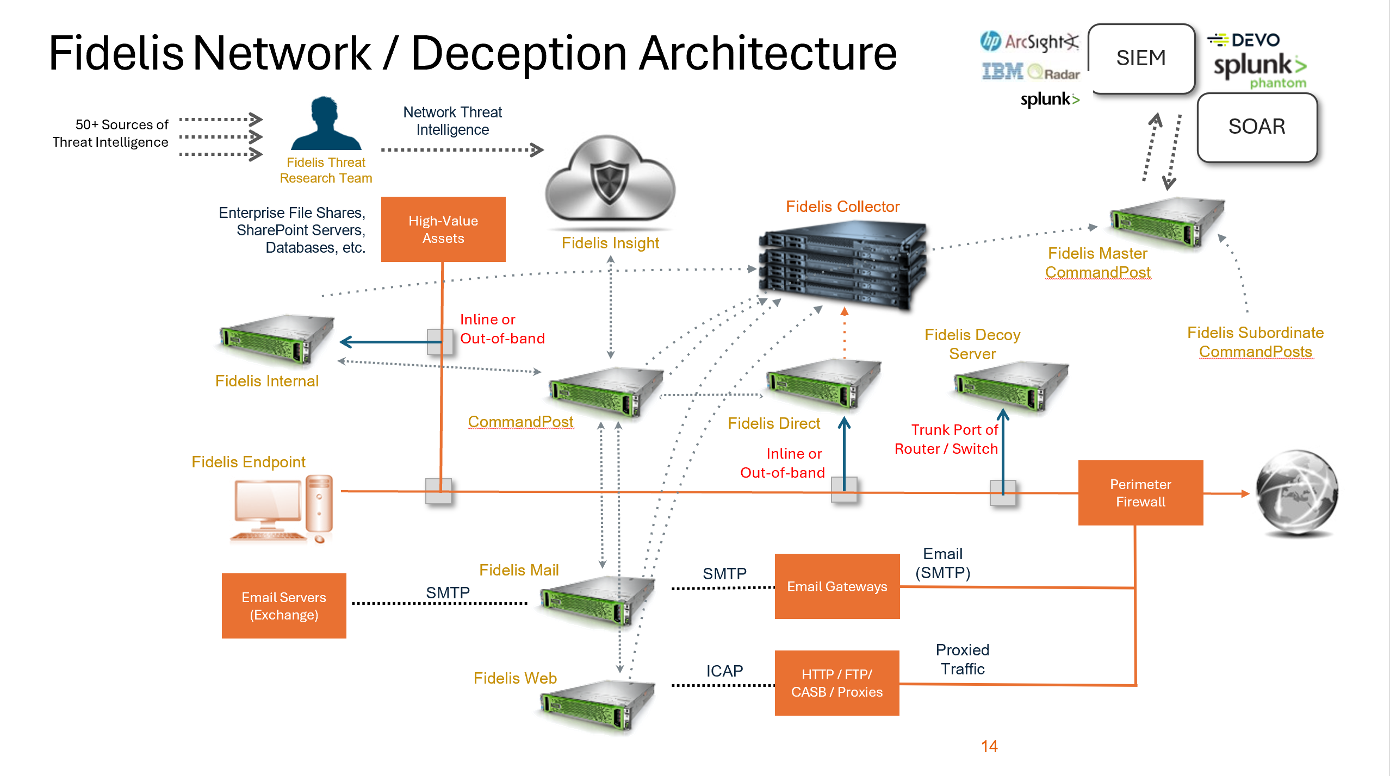
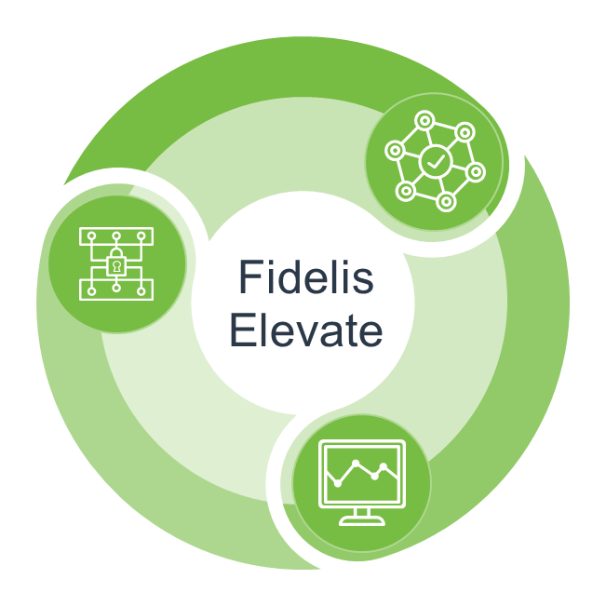
Fidelis Network®: Deep, Rich Analysis and Threat Detection
Prevent Data Loss
6 Critical Areas in a Single Solution
Fully integrated, automated and correlated for you
Automated threat detection and
hunting platform
  Map your cyber terrain (Cloud, enterprise, WFA)
  Deep visibility into embedded content, inbound and outbound, across all ports and protocols
  Real-time & historical detection & investigation
  See lateral movement
  Multiple detection methods across the kill chain
  Embedded sandboxing
  Prevent data exfiltration
Available in the Cloud and On-Prem
Fidelis Network®
Fidelis Endpoint®
Fidelis Deception®
Fully Integrated, One License, No Modules
Content, gateway, internal network, email, web, and cloud sensors

Slide 14
Fidelis Network®: Deep, Rich Analysis and Threat Detection
Prevent Data Loss
6 Critical Areas in a Single Solution
Fully integrated, automated and correlated for you
Automated threat detection and
hunting platform
  Map your cyber terrain (Cloud, enterprise, WFA)
  Deep visibility into embedded content, inbound and outbound, across all ports and protocols
  Real-time & historical detection & investigation
  See lateral movement
  Multiple detection methods across the kill chain
  Embedded sandboxing
  Prevent data exfiltration
Available in the Cloud and On-Prem
Fidelis Network®
Fidelis Endpoint®
Fidelis Deception®
Fully Integrated, One License, No Modules
Content, gateway, internal network, email, web, and cloud sensors

Slide 15

Start with Full Visibility
Know your terrain better than your adversary
Visualize your full terrain mapping with risk assessment
Track all network traffic, including:
  On-premises and cloud
  Web, email, inbound, outbound, internal, and more, across all ports and protocols
  Transport Layer Security (TLS)
Catch risks other tools miss, with:
  Patented Deep Session Inspection®
  Encrypted traffic analysis
Assets
Known & Unknown
OS
Know
Your
Terrain
Subnets
Ports
Applications
Servers

Slide 16
Deep Session Inspection®
Configuration, Investigation, Analysis, Response, Integration
Fidelis CommandPost
Fidelis Collector
Non-Selective Network Memory
Fidelis
Sensors
DEEP SESSION INSPECTION®
Content Analysis,
Malware Detection
Real-Time Threat Detection
Deep Content
Decoding
Metadata and Tags
Protocol and
Application Decoding
Full Session
Reassembly
Network

Slide 17
Fidelis Endpoint®: Accelerate and Automate Investigation
Best-in-Class Across 8 Critical Areas in a Single Solution (and 1 Agent)
EDR, System Management, Forensics – all via a single management and investigation UI
  Visibility of what’s on your endpoints and all endpoint activity
  Real-time threat detection and proactive hunting
  Timeline view of malware and endpoint behaviors
  Real-time and historical validation and investigation
  Remote forensics: memory analysis, collection, full disk imaging
  Out-of-the-box and customizable remediation
  Seamless integration, automation and correlation
  Easy integration with Fidelis Network and SIEMs
  Managed in the Cloud & On-Prem
Fidelis Network®
Fidelis Endpoint®
Fidelis Deception®
Fully Integrated, One License, No Modules

Slide 18
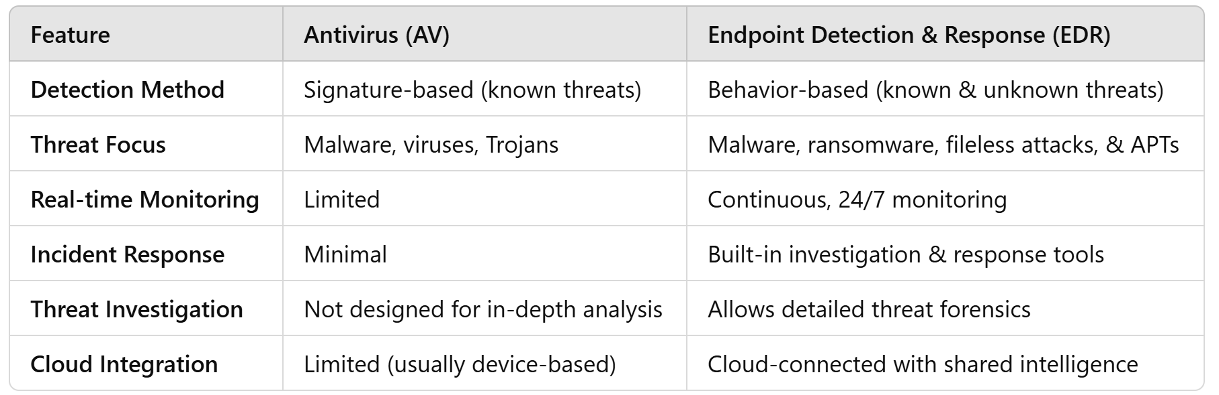
Key Differences between EDR & Antivirus
Choosing the right solution depends on your organization’s risks

Slide 19
Fidelis Endpoint Detection and Response
Monitor and Defend Your Endpoints On and Off Your Network – No Matter Where They Are
Detonate suspicious objects and detect malicious behavior without risking host machines.
Fidelis Sandbox
Fidelis Insight
Curated threat intelligence, providing behavior-based detection mapped to Mitre ATT&CK techniques
Greater Visibility and Deeper Insights
Advanced, Real-time Threat Detection
Forensic Analysis
Validate, Investigate and Triage Alerts, Malware and Endpoint Behavior
Containment and Out-of-the box or
Customizable Remediation
Automated Incident Response
Embedded sandboxing
Coexist with EPP of choice
Agent
Third Party
Intel Feeds
Windows, OSX, Linux
Collect process data, user activity, registry events, file system activity and more, in real time
Response task execution and data collection
Share
data with
SIEM
SOAR
NGFW
Etc…
Endpoint Server
Windows, OSX, Linux
Optional signature, behavior Malware Detection and Blocking
Hosted, Cloud or On-Prem
Advanced threat hunting and incident response, in real-time or retrospectively through recorded events
Integration API
AV Module
Extensive and Extensible response script library
Script Library

Slide 20

Fidelis Deception®: Turn the Tables on Cyber Adversaries
Best-in-Class Deception
Wide Array of Decoys and Breadcrumbs
Detect lateral movement and attacker actions, with high fidelity alerts from decoys, breadcrumbs, fake accounts and data
Gain visibility and protect assets where you cannot deploy an agent - enterprise IoT, Shadow IT and legacy systems
Profile and classify assets to determine deception layers
Flexible decoy options to address your use case
  Real OS VM, golden image or customer desired decoys
  Emulation decoys for low-risk interaction and file uploads
  Automate decoy updates to match your real environment
  Seed multiple lures in the Network, Assets (breadcrumbs) and AD
  Seamless workflows with Fidelis Network and Endpoint
Fidelis Network®
Fidelis Endpoint®
Fidelis Deception®
Fully Integrated, One License, No Modules

Slide 21
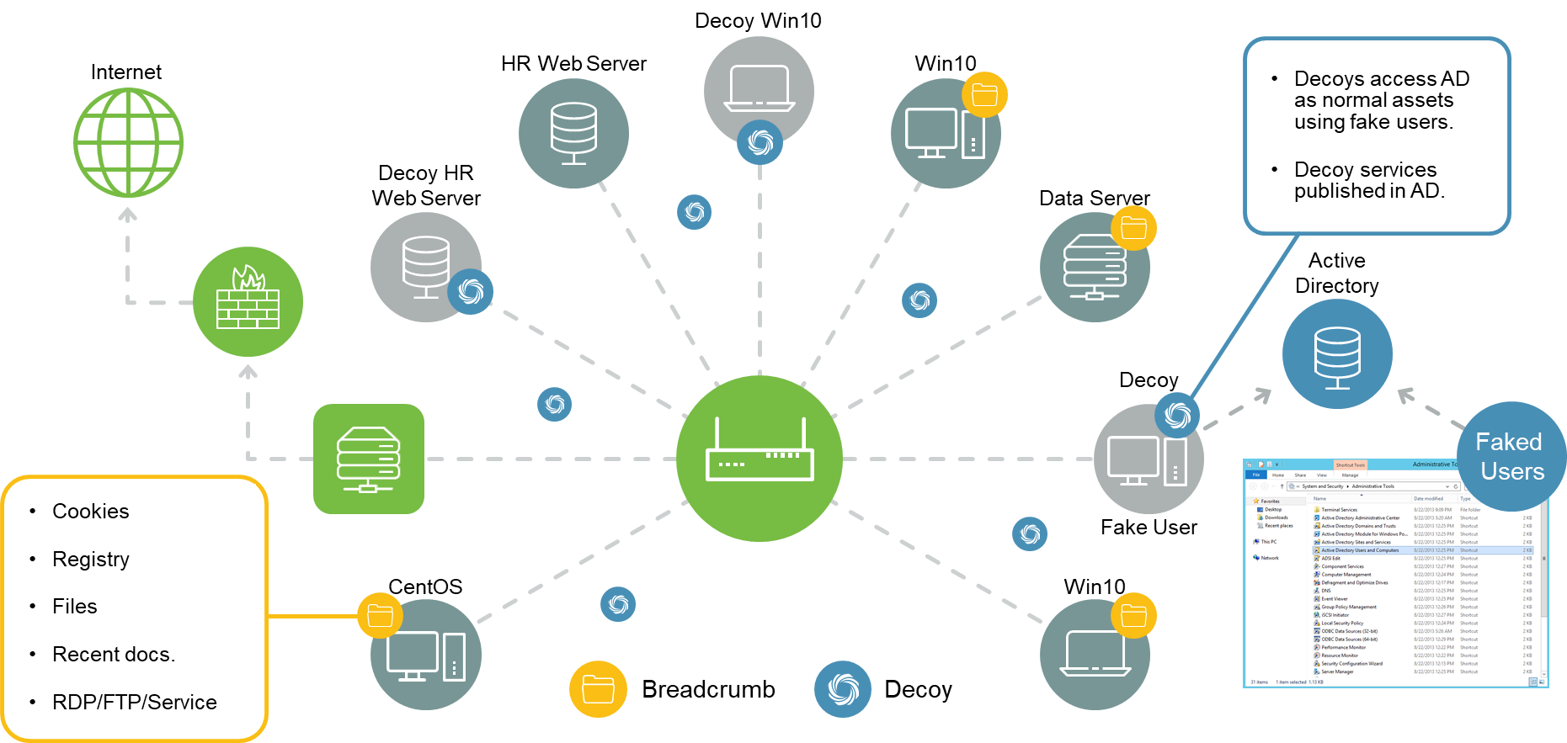
Fidelis Deception: Re-Shape the Attack Surface
Confuse and Deter Adversaries While You Prevent Their Success

Slide 22


Automated Active Deception
Continually shift the deception layer to fool even the most sophisticated attacker
Decoys:
Hardware: Laptops, servers, routers, switches, cameras, printers, enterprise IoT devices, etc.
Software: OS, apps, ports, services, applications, cloud assets, and similar data
Breadcrumbs:
Files, documents, emails, applications, memory credentials, registry keys, system resources, network activities, etc.
Reduce
Dwell
Time
Preventive
Defenses
Deception
Lures & Decoys

Slide 23
Fidelis Elevate®
Summary and Conclusions

Slide 24

Fidelis Elevate - multifunctional platform
Supported by 20+ detection methods incl. anomalies, ML, AI and Sandboxing
Multi Use Cases
Deep Session Inspection®
Deep vizibility on network and endpoint
Cyber threats prevention and detection
Active investigation and hunting
DLP – preventing data exfiltration
Endpoint detection and response (EDR+AV)
E-mail security - prevention
Proactive detection – intelligent deception system
Terrain mapping, vulnerabilities identification
Incident response (IR), forensic analysis
Fast
Incident Response
Adaptive Deception
Threat-informed
Forensics
Real-time
Risk Analysis
ML Analytics & Curated Threat Research
Predictive
Anomaly Detection
Endpoint
Threat
Protection
Active Directory Intercept™
Active Threat Detection™
Our professionals have helped remediate some of the world’s most high-profile security breaches including more than 4,000 security cases in both the commercial and government sectors and have provided expert testimony in over 100 court proceedings

